Slide 1

Simulation of LPIM by SPH in DualSPHysics
Montréal, May 19, 2020
2nd follow up meeting
Research Directors:
Professor Vincent Demers
Professor Louis Dufresne
Presented by:
Mohammad Meiabadi

Slide 2
Outline
Computational Time to be Addressed
Simulation of Injection of Sanvick Feedstock
Comparison of DualSPHysics with Moldflow and Experimental Data
Results Instability

Slide 3
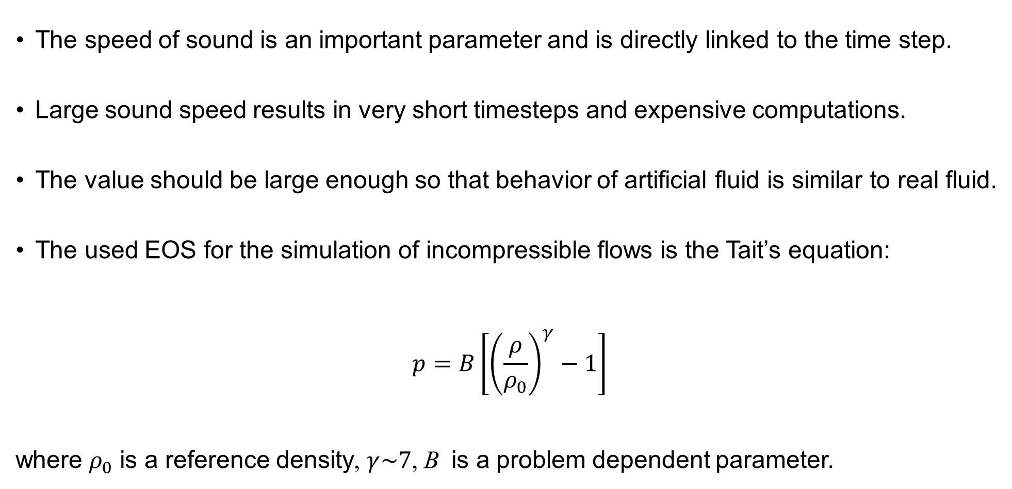
Computational Time to be Addressed
The speed of sound is an important parameter and is directly linked to the time step.
Large sound speed results in very short timesteps and expensive computations.
The value should be large enough so that behavior of artificial fluid is similar to real fluid.
The used EOS for the simulation of incompressible flows is the Tait’s equation:
$$p=B\left[{\left(\frac{ρ}{ρ_{0}}\right)}^{γ}−1\right]$$
where $ρ_{0}$ is a reference density, $γ\sim 7$, B is a problem dependent parameter.
Notes:
that limits the maximum change of density during the simulation.

Slide 4
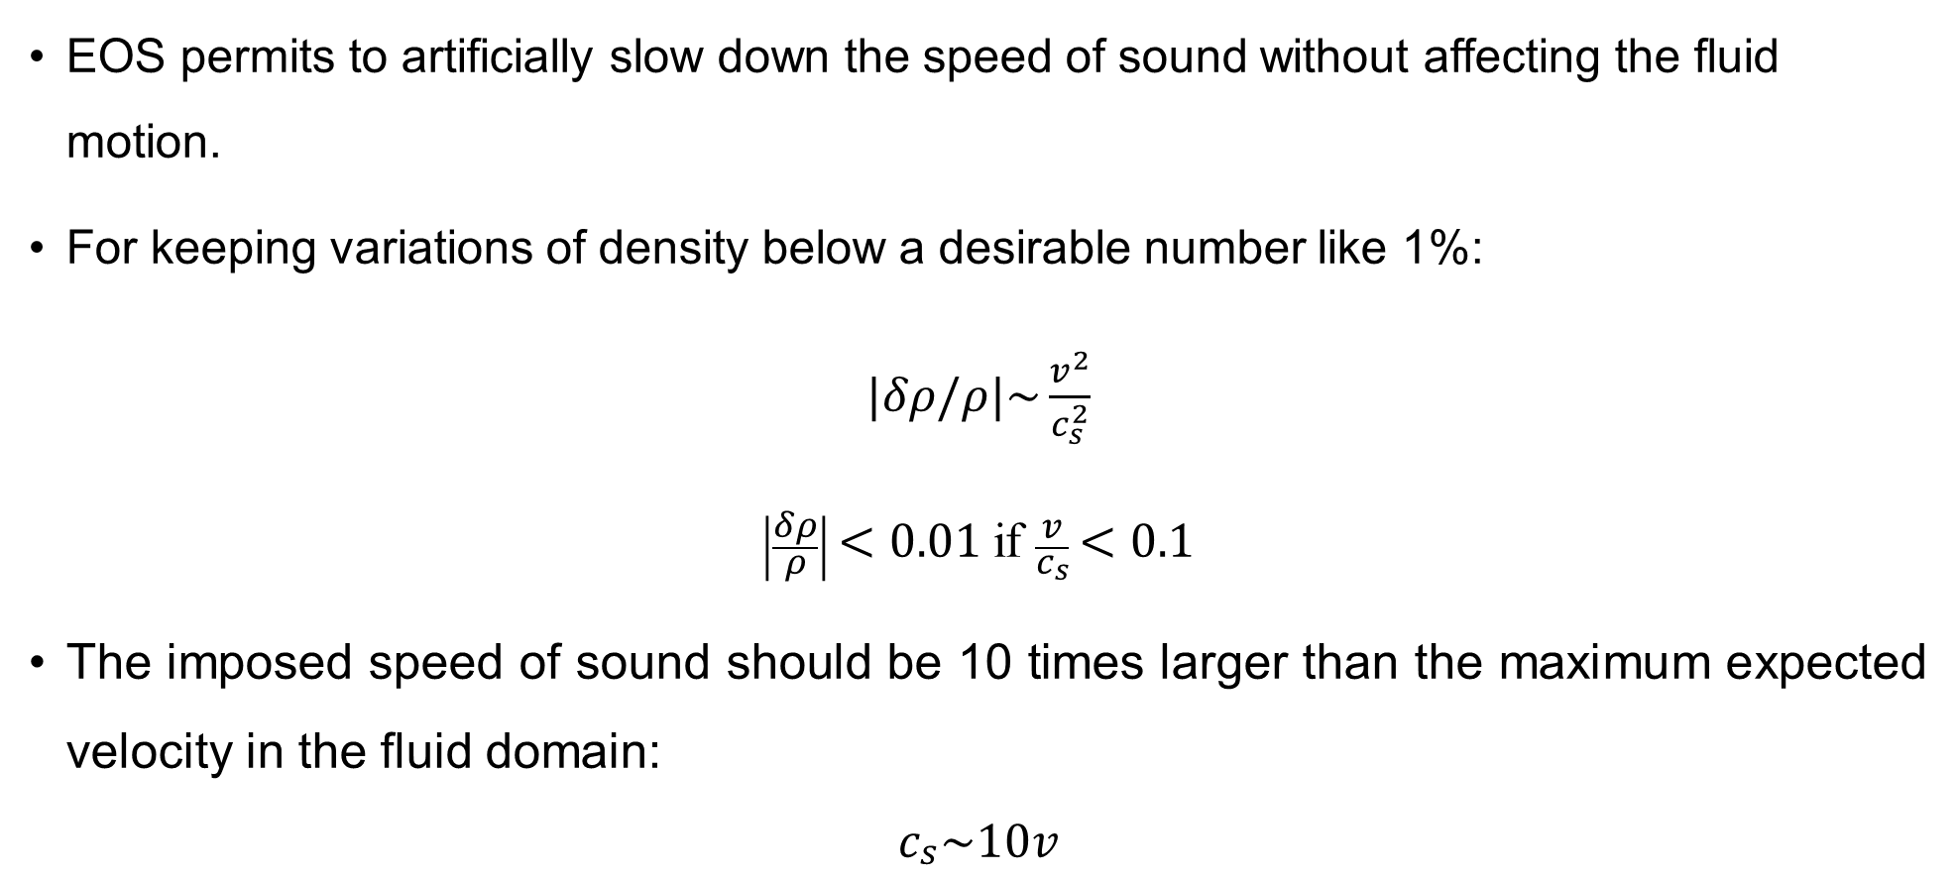
Computational Time to be Addressed
EOS permits to artificially slow down the speed of sound without affecting the fluid motion.
For keeping variations of density below a desirable number like 1%:
$|δρ/ρ|\sim \frac{v^{2}}{c_{s}^{2}}$
$\left|\frac{δρ}{ρ}\right|<0.01$ if $\frac{v}{c_{s}}<0.1$
The imposed speed of sound should be 10 times larger than the maximum expected velocity in the fluid domain:
$$c_{s}\sim 10v$$

Slide 5

Computational Time to be Addressed
Fluid: PF-20F feedstock
Total Particles: 30336
Run time: 20 hours on Beluga
Viscosity model: HBP
Time of simulation: 6 s
flow front distance

Slide 6
HBP Viscosity Model to Describe Sanvick
T=80 C
Shear rate | HBP Model
0.01 | 13.42345
0.02 | 12.91675
0.04 | 12.4328
0.06 | 12.14374
0.08 | 11.92766
0.1 | 11.74953
0.2 | 11.09558
0.3 | 10.60041
0.4 | 10.17463
6
Notes:
In fact, HBP model has two part, one part is PLM. The interesting point is about second part because the duty of the second part is to help the viscosity model to behave like a Newtonian fluid at very low shear rate range what is PLM can not do alone.

Slide 7
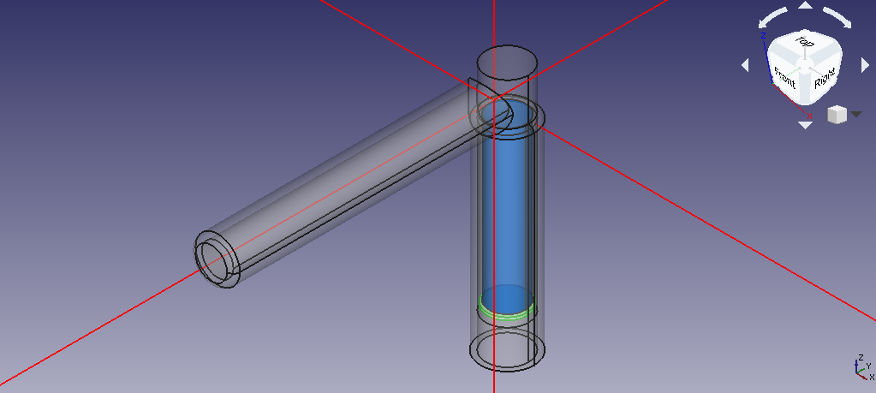
Cylinder Filling by Modelling of Injection Unit
Injection unit STL file
Notes:
• Speedup and efficiency are measures of the quality of parallel algorithms

Slide 8
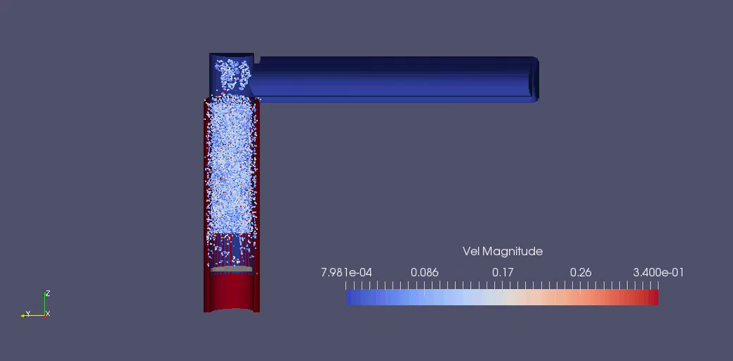
Cylinder Filling by Modelling of Injection Unit
Injection animation
Notes:
• Speedup and efficiency are measures of the quality of parallel algorithms

Slide 9


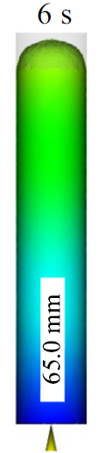

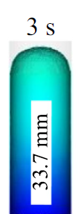

DualSPHysics vs Moldflow and Experiment
Flow front distance | 3s | 6s
Moldflow | 33.7 mm | 65 mm
DualSPHysics | 35 mm | 67.5 mm
Experimental data | 34.2 mm | 62.6 mm
6 s
3 s
67 mm
35 mm

Slide 10
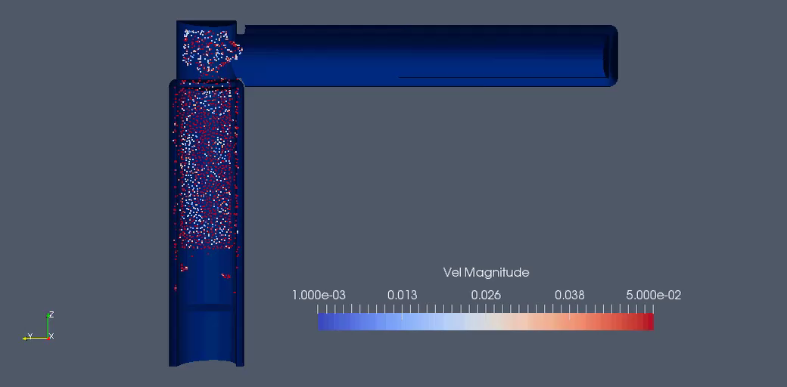
Non-Newtonian Velocity Results
Instability in velocity results
Measures to reduce insatiability:
Change kernel function
Shifting algorithm
Density diffusion term
Time integration scheme
Notes:
• Speedup and efficiency are measures of the quality of parallel algorithms

Slide 11
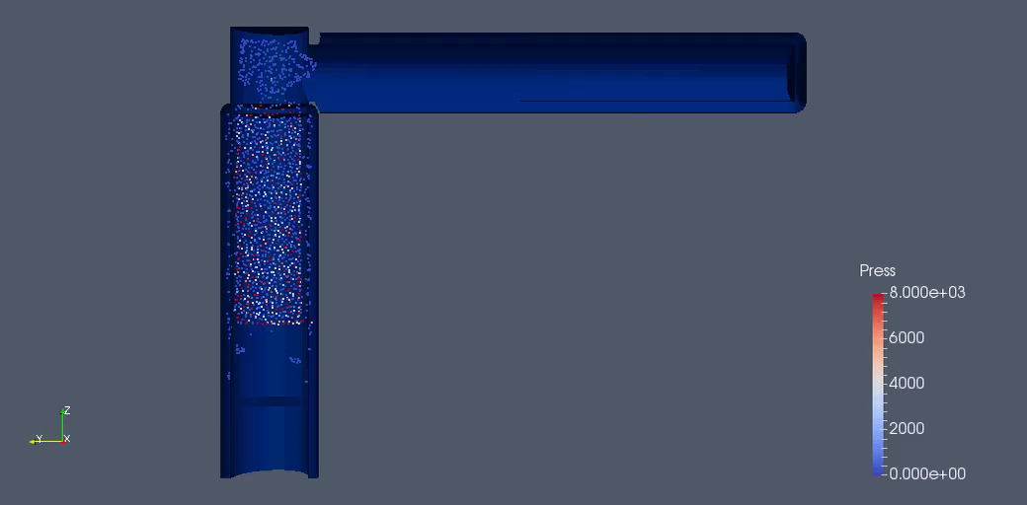
Non-Newtonian Pressure Results
Instability in pressure results
Measures to reduce insatiability:
Change kernel function
Shifting algorithm
Density diffusion term
Time integration scheme
Notes:
• Speedup and efficiency are measures of the quality of parallel algorithms

Slide 12
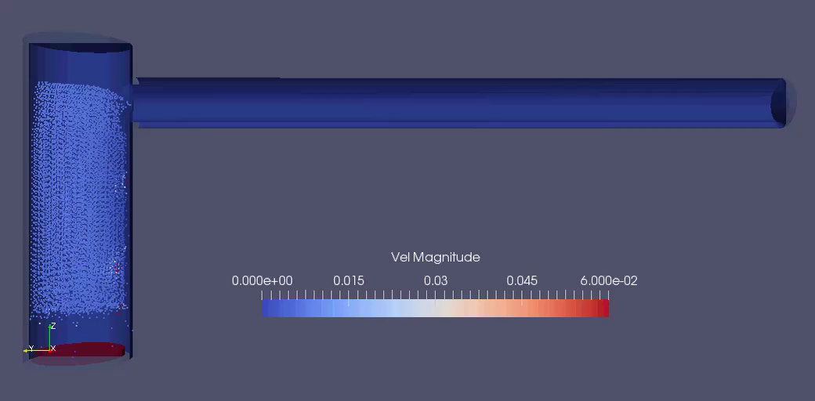
Newtonian Velocity Results
Less instability
Notes:
• Speedup and efficiency are measures of the quality of parallel algorithms

Slide 13
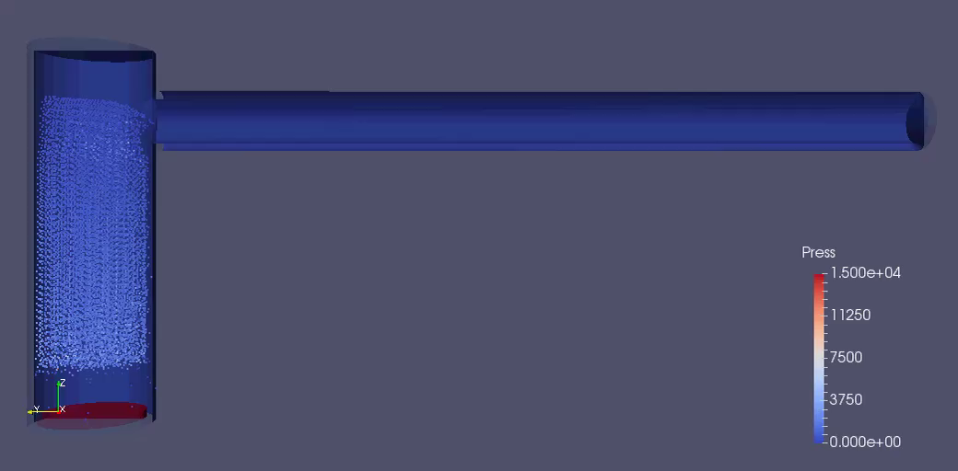
Newtonian Pressure Results
Less instability
Notes:
• Speedup and efficiency are measures of the quality of parallel algorithms

